Slide 1
CMSC201 Computer Science I for Majors Lecture 16 – Recursion

Slide 2
Last Class We Covered
What makes “good code” good
Readability
Adaptability
Commenting guidelines
Incremental development
#TBT
Function Returns

Slide 3
Any Questions from Last Time?

Slide 4
Today’s Objectives
To introduce recursion
To better understand the concept of “stacks”
To begin to learn how to “think recursively”
To look at examples of recursive code
Summation, factorial, etc.

Slide 5
Introduction to Recursion

Slide 6
What is Recursion?
In computer science, recursion is a way of thinking about and solving problems
It’s actually one of the central ideas of CS
In recursion, the solution depends on solutions to smaller instances of the same problem

Slide 7
Recursive Solutions
When creating a recursive solution, there are a few things we want to keep in mind:
We need to break the problem into smaller pieces of itself
We need to define a “base case” to stop at
The smaller problems we break down into need to eventually reach the base case

Slide 8
Normal vs Recursive Functions
So far, we’ve had functions call other functions
For example, main() calls the square() function
A recursive function, however, calls itself
main()
square()
countdown()

Slide 9
Why Would We Use Recursion?
In computer science, some problems are more easily solved by using recursive methods
For example:
Traversing through a directory or file system
Traversing through a tree of search results
Some sorting algorithms recursively sort data
For today, we will focus on the basic structure of using recursive methods

Slide 10
Toy Example of Recursion
def countdown(intInput):
print(intInput)
if (intInput > 2):
countdown(intInput-1)
def main():
countdown(50)
main()
This is where the recursion occurs.
You can see that the countdown() function calls itself.
What does this program do?
This program prints the numbers from 50 down to 2.

Slide 11
Visualizing Recursion
To understand how recursion works, it helps to visualize what’s going on
Python uses a stack to keep track of function calls
A stack is an important computer science concept
To help visualize, we will

Slide 12
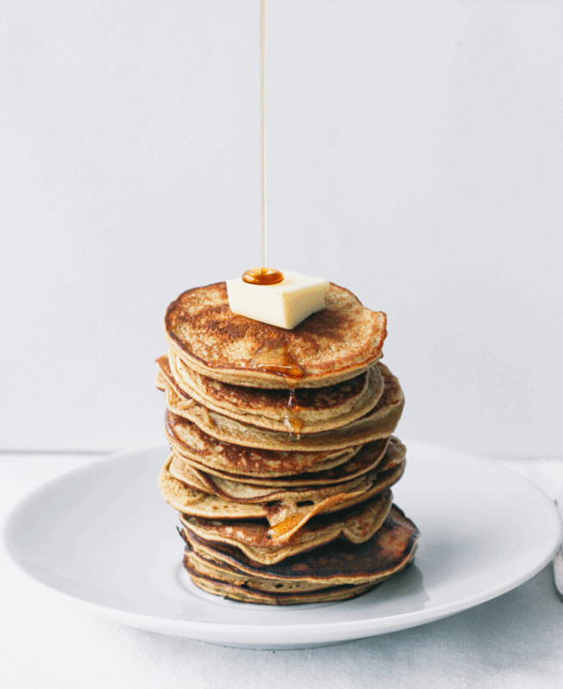
Stacks

Slide 13
Stacks
A stack is like a bunch of lunch trays in a cafeteria
It has only two operations:
Push
You can push something onto the top of the stack
Pop
You can pop something off the top of the stack
Let’s see an example stack in action

Slide 14
Stack Example
In the animation below, we “push 3”, then “push 8”, and then pop twice
8
8
3
3
3
3
Time 0
Time 1
Time 2
Time 3
Time 4
Empty
Push 3
Push 8
Pop
Pop

Slide 15
Stack Details
In computer science, a stack is a last in, first out (LIFO) data structure
It can store any type of data, but has only two operations: push and pop
Push adds to the top of the stack, hiding anything else on the stack
Pop removes the top element from the stack

Slide 16
Stack Details
The nature of the pop and push operations also means that stack elements have a natural order
Elements are removed from the stack in the reverse order to the order of their addition
The lower elements are those that have been in the stack the longest

Slide 17
Stack Exercise
In your notebooks, trace the following commands, to the stack’s final appearance
Push “D”
Push “O”
Push “D”
Pop
Push “G”
Push “M”
Push “K”
Pop
Push “T”
Pop
Pop
Push “G”
Push “E”
Push “F”
Pop
Push “H”
Pop
Push “S”

Slide 18
Stacks and Functions
When you run your program, the computer creates a stack for you
Each time you call a function, the function is pushed onto the top of the stack
When the function returns or exits, the function is popped off the stack

Slide 19
Stack Example
Run
square(7)
square(7)
main()
main()
main()
main()
Time 0
Time 1
Time 2
Time 3
Time 4
Empty
Call main()
Call square(7)
square() returns
main() ends

Slide 20
Stacks and Recursion
If a function calls itself recursively, you push another call to the function onto the stack
We now have a simple way to visualize how recursion really works

Slide 21
Toy Example of Recursion
def countdown(intInput):
print(intInput)
if (intInput > 2):
countdown(intInput-1)
def main():
countdown(50)
main()
Here’s the code again.
Now, that we understand stacks, we can visualize the recursion.
We’ll call the function with a value of just 4 for the trace.
We’ll also shorten it to cDown().

Slide 22
Stack and Recursion in Action
Skipping time step 0, start by pushing main()…
cDown(2)
cDown(2)
cDown(3)
cDown(3)
cDown(3)
cDown(4)
cDown(4)
cDown(4)
cDown(4)
main()
main()
main()
main()
main()
main()
Time 1
Time 2
Time 3
Time 4
Time 5
Time 8
Time 6, 7…

Slide 23
Defining Recursion

Slide 24
“Cases” in Recursion
A recursive function must have two things:
At least one base case
When a result is returned (or the function ends)
“When to stop”
At least one recursive case
When the function is called again with new inputs
“When to go (again)”

Slide 25
Terminology
def fxn(n):
if n == 1:
return 1
else:
return fxn(n - 1)
Notice that the recursive call is passing in simpler input, approaching the base case
base case
recursive case
recursive call

Slide 26
Recursion Example
def summ(n):
if n == 1:
return 1
else:
return n + summ (n - 1)
What is summ (1) ?
What is summ (2) ?
What is summ (100) ?
We at least know that it’s 100 + summ(99)

Slide 27
Recursion Example
def summ(n):
if n == 1:
return 1
else:
return n + summ (n - 1)
summ(3)
3 + summ(2)
2 + summ(1)
1
3 + 2 + 1 = 6

Slide 28
Factorials
4! = 4 × 3 × 2 × 1 = 24
Does anyone know the value of 9! ?
362,880
Does anyone know the value of 10! ?
How did you know?

Slide 29
Factorial
9! = 9×8×7×6×5×4×3×2×1
10! = 10 × 9×8×7×6×5×4×3×2×1
10! = 10 × 9!
n! = n × (n - 1)!
That's a recursive definition!
The answer to a problem can be defined as a smaller piece of the original problem

Slide 30
Factorial
def fact(n):
return n * fact(n - 1)
fact(3)
3 * fact(2)
2 * fact(1)
1 * fact(0)
0 * fact(-1)
...
What happened? What went wrong?

Slide 31
Factorial (Fixed)
def fact(n):
if n == 0:
return 1
else:
return n * fact(n - 1)
fact(3)
3 * fact(2)
2 * fact(1)
1 * fact(0)
1

Slide 32
Recursion Practice

Slide 33
Thinking Recursively
Anything we can do with a while loop can also be accomplished through recursion
Let’s get some practice by transforming basic loops into a recursive function
To keep in mind:
What is the base case? The recursive case?
Are we returning values, and if so, how?

Slide 34
Non-Recursive sumList()
Sum the contents of a list together
def sumList(numList):
total = 0
for i in range(len(numList)):
total = total + numList[i]
return total
Transform this into a recursive function

Slide 35
Recursive sumList()
Recursively sum the contents of a list together
def recSumList(currList, index, total):
# BASE CASE: reached the end of the list
if index == len(currList):
return total
else:
total += currList[index]
# RECURSIVE CALL: call with updated index
return recSumList(currList, index+1, total)
this return is very important

Slide 36
Recursive sumList()
Recursively sum the contents of a list together
def recSumList(currList, index):
# BASE CASE: reached the end of the list
if index == len(currList):
return 0
else:
# RECURSIVE CALL: add this element to rest of list
print("Adding", currList[index], "to total")
return currList[index] + \
recSumList( currList, index+1 )

Slide 37
Recursive Thinking
Sometimes, creating a recursive function requires us to think about the problem differently
What kind of base case do we need for summing a list together? How do we know we’re “done”?
Instead of approaching the problem as before, you could think of it instead as adding the first element to the sum of the rest of the list

Slide 38
Recursive Summing
myList = [3, 5, 8, 7, 2, 6, 1]
3 + [5, 8, 7, 2, 6, 1]
5 + [8, 7, 2, 6, 1]
8 + [7, 2, 6, 1]
etc...
What is the base case here?
How does the recursive case work?

Slide 39
Recursive sumList()
Recursively sum the contents of a list together
def recSumList(currList):
# BASE CASE: no elements left (empty list)
if len(currList) == 0:
return 0
else:
# RECURSIVE CALL: add first element to rest of list
print("Adding", currList[0], "to", currList[1:] )
return currList[0] + recSumList( currList[1:] )
again, this return is very important

Slide 40
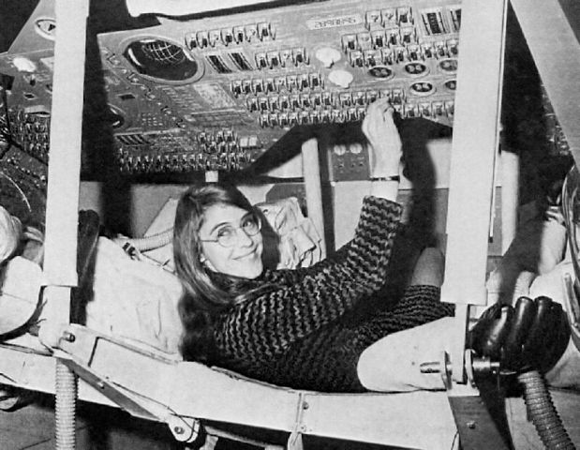
Daily CS History
Margaret Hamilton
Who is she?
The original Hamilton
We’ll cover her next time

Slide 41
Announcements
Project 2 is out on Blackboard now
Design is due by Friday (Apr 12th) at 11:59:59 PM
Project is due by Friday (Apr 19th) at 11:59:59 PM
Significantly more difficult than Project 1
Probably at least at 10 hour project (closer to 15)
Second midterm exam is April 17th and 18th

Slide 42
Image Sources
Pancake drizzle:
http://www.topwithcinnamon.com/2013/01/2-ingredient-healthy-pancakes-gluten-free-dairy-free.html
Margaret Hamilton
https://en.wikipedia.org/wiki/File:Margaret_Hamilton_in_action.jpg

